Slide 1


Web-Based Event Planning System
SE2030 Software Engineering | Year 2, Semester 1, 2026
Group ID: 2026-Y2-S1-MLB-B10G1-02 | SLIIT
Chathuranga B.G.
IT25101514
Wickramarathna W.L.S. IT25102322
Keshavan M.
IT25103301
Suriyage O.W.
IT25100916
Gunasekara N.B.
IT25102923
Wickramasinghage C.P.W. IT25100220

Slide 2

Project Overview & Objectives
The Problem Statement
Centralized Event Platform
Traditional event planning relies heavily on fragmented channels like direct calls, emails, messaging apps, and spreadsheets.
A unified Web Application consolidating coordinators, venue owners, vendors, inventory staff, and clients into a single digital workspace.
This leads to major operational flaws: communication gaps, double-booking errors, delayed approvals, and lost inventory records.
▪
Automation: Real-time booking locks & workflows.
▪
Error Reduction: Eliminates missing assets & conflicts.
▪
Role Dashboards: Targeted tools for all users.

Slide 3
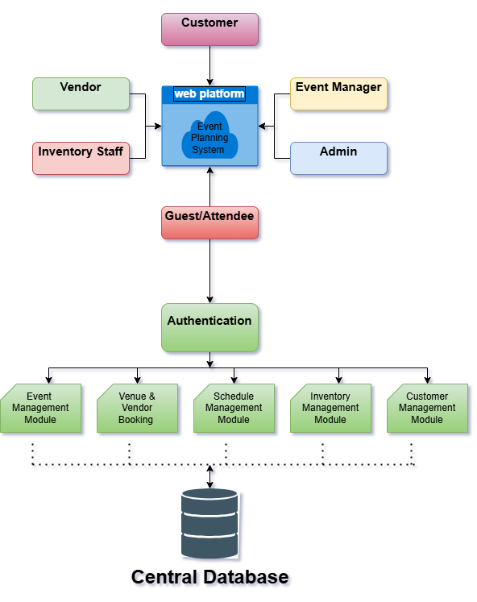

System Architecture Overview
Modular Architecture
The system operates around a centralized database storing user profiles, event schedules, vendor listings, and stock counts.
Authentication Layer: Enforces Role-Based Access Control (RBAC).
6 Core Functional Modules: Communicate directly through REST APIs.
Centralized Database: Ensures data synchronization across all user sessions.

Slide 4
Functional Requirements
What the System Must Do
FR1: Account & Authentication Management: User registration, role enforcement (Customer, Vendor, Manager, Admin), and secure login with OTP password reset.
FR2: Event Creation & Lifecycle Management: Draft, view, update, and track event progress states (Draft, Pending Approval, Approved, Completed).
FR3: Venue & Vendor Booking: Real-time filtering, calendar slot locks to prevent double-booking, and payment status logging.
FR4: Schedule & Activity Management: Visual interactive timelines, operational staff task assignments, and automated deadline alerts.
FR5: Inventory Tracking: Real-time stock level allocation (chairs, tables, AV gear), post-event return logs, and safety stock alerts.
FR6: Customer Management: Detailed customer profiles, booking history archives, and interaction logging.

Slide 5





Non-Functional Requirements
The Qualities Behind the Features
Performance
Security
Usability
Uptime & Scale
Supports up to 500 concurrent active users with page response times under 2.0 seconds.
HTTPS with SSL/TLS encryption. Passwords hashed using bcrypt prior to database storage.
Fully responsive Web UI optimized across desktop, tablet, and mobile browsers.
99.5% uptime with daily automated database backups and modular REST API microservices.

Slide 6
Major Stakeholders & Users
Stakeholder | Primary Responsibilities | System Value Derived
Administrator | Manages platform access, role permissions, system audit logs, and reports. | Full governance and maintenance capability.
Customer | Creates event requests, selects venue/vendors, tracks timelines and payments. | Single dashboard eliminates scattered channels.
Event Manager | Verifies plans, creates schedules, approves bookings, and assigns staff. | Automated scheduling and workflow control.
Vendor / Partner | Lists services, manages schedule availability, accepts/rejects bookings. | Direct customer reach & calendar locks.
Inventory Staff | Tracks physical asset allocation, stock levels, and post-event returns. | Prevents gear shortages and missing stock.
Guest / Attendee | Views public event details, itineraries, and registers attendance. | Convenient access to schedule updates.

Slide 7

Major Functions (1 & 2)
1. Registration & Authentication
2. Event Creation & Management
Target: All System Users
Target: Customer, Event Manager
▪
User registration with explicit role selection.
▪
Create event drafts with date, location, guest count.
▪
Secure credential authentication (bcrypt check).
▪
Role-Based Access Control (RBAC) session guards.
▪
Comprehensive event summary dashboards.
▪
Update event parameters during planning phases.
▪
Email / OTP password reset and recovery flow.
▪
Secure single-click session logout.
▪
Event cancellation & deletion mechanisms.
▪
Real-time status tracking (Draft to Approved).

Slide 8
Major Functions (3 & 4)
3. Venue & Vendor Booking
4. Schedule & Activity Management
Target: Customer, Vendor, Manager
Target: Manager, Ops Staff, Guests
▪
Filter vendors by availability, category, and price.
▪
Construct master activity timelines for events.
▪
Real-time slot calendar locks against double-booking.
▪
Assign operational tasks to specific staff members.
▪
Direct booking request submission and acceptance.
▪
Update task execution status in real-time.
▪
Process booking payments & log transaction status.
▪
Multi-event visual calendar view integration.
▪
Automated notification alerts for task deadlines.
▪
Modify or cancel existing vendor reservations.

Slide 9
Major Functions (5 & 6)
5. Inventory & Equipment
6. Customer & Profile Management
Target: Inventory Staff, Manager, Admin
Target: Customer, Manager, Admin
▪
Add and categorize physical assets (AV, seating).
▪
Maintain structured customer profiles & contact info.
▪
Track real-time stock allocation across active events.
▪
Log interaction history and customer preferences.
▪
Stock level updates upon damage or addition.
Reserve specific item quantities per event schedule.
▪
Update customer preference and communication settings.
▪
▪
Retrieve historic booking data and financial summaries.
▪
Record post-event returns & asset condition reports.
▪
Archive or safely remove inactive customer entries.

Slide 10





Minor Supporting Functions
Session Management
Password Recovery
System Notifications
Data Reporting
Standardized login and secure logout handling, providing encrypted session tokens across all modules.
Email-based recovery links or temporary verification codes allowing users to safely regain account access.
Automated email and in-app alerts sending real-time updates regarding booking approvals and tasks.
Basic statistical exports delivering PDF/CSV summaries for event costs, booking history, and system usage.

Slide 11
Limitations & Constraints
Browser Requirements: Requires modern web browsers (Chrome, Firefox, Safari, Edge) with JavaScript enabled.
Network Dependence: Real-time database synchronization requires an active internet connection; no offline mode in V1.0.
Third-Party API Limits: External email and notification services are subject to third-party rate limits and gateway operational costs.
Payment Scope Assumption: Version 1.0 records payment status logs; direct payment gateway handling (e.g., Stripe) is reserved for future expansion.

Slide 12





Project Timeline (Week 3 - 14)
Week 4-5
Week 8-10
Week 13
SRS Drafting, Use Cases & Architecture
Backend API & DB Implementation
UAT Testing, Bug Fixes & Documentatio-n
Week 3
Week 6-7
Week 11-12
Week 14
Proposal Submission & Viva Presentation
Database ERD, Wireframes & Setup
Frontend Development & Integration
Code Freeze, Deployment & Final Viva

Slide 13

Conclusion
The proposed Web-Based Event Planning System directly eliminates communication gaps, manual scheduling errors, double bookings, and asset misallocations.
By unifying all stakeholder operations under 6 clear, member-owned functional modules with incremental sprint integrations, our team is well-positioned to complete the project on schedule.

Slide 14
Questions & Discussion
Thank you for your time!

